Slide 1
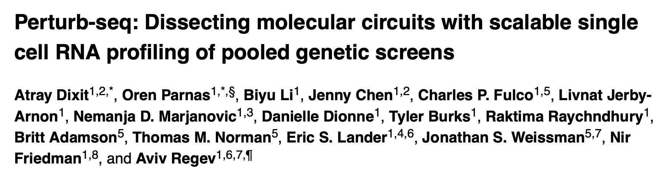
LatAm Single Cell Community – Journal Club #1
Samuel Eyrolle-Cellier – September 15th, 2025

Slide 2
Presentation Outline
Introduction
Genetic screens before Perturb-seq
CRISPR-Cas9 tool mechanism
Perturb-seq Experimental Design
Scalable single-cell RNA profiling of pooled genetic screens
CRISPR plasmid design for perturbation identification at the single-cell resolution
Effects of sgRNAs on target gene expression
The MIMOSCA Modelling Framework
How to estimate the impact of perturbations on gene expression?
What is a covariate? Which covariates are included in MIMOSCA?
Incorporating genetic interactions into the model
Experimental Validation: BMDC Response to LPS
Experimental design
Mode of action of transcription factors
Controls before data analysis
Findings: Transcription factor modules and gene programs; Seven distinct BMDC cell states under LPS stimulation; Complex transcription factor circuits and interactions
Discussion
Advantages and limitations of Perturb-seq
Potential improvements
How could you use this kind of approach in your own research project?

Slide 3
Introduction

Slide 4
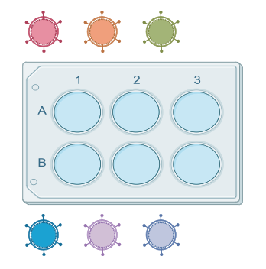

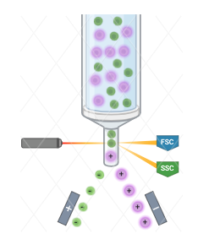

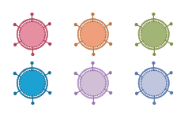
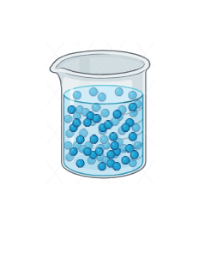

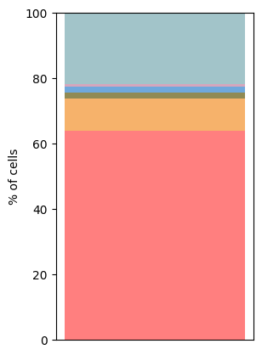

Genetic screens before Perturb-seq
Arrayed screens
Pooled screens
Each gene perturbation (KD, KO, overexpression) is tested individually. Cell phenotype is then measured for that specific perturbation.
All perturbations are introduced together into a single population of cells, with each cell randomly receiving one perturbation linked to a DNA barcode. After selecting cells based on a simple phenotype of interest (such as surface marker expression, drug resistance, or proliferation), the barcodes are sequenced to identify which perturbations are enriched or depleted.
1
2
3
5.000-20.000 cells/well
1
2
3
4
5
6
4
5
6
Selection of cells
% of cells
Millions of cells
Readout content
Throughput

Slide 5
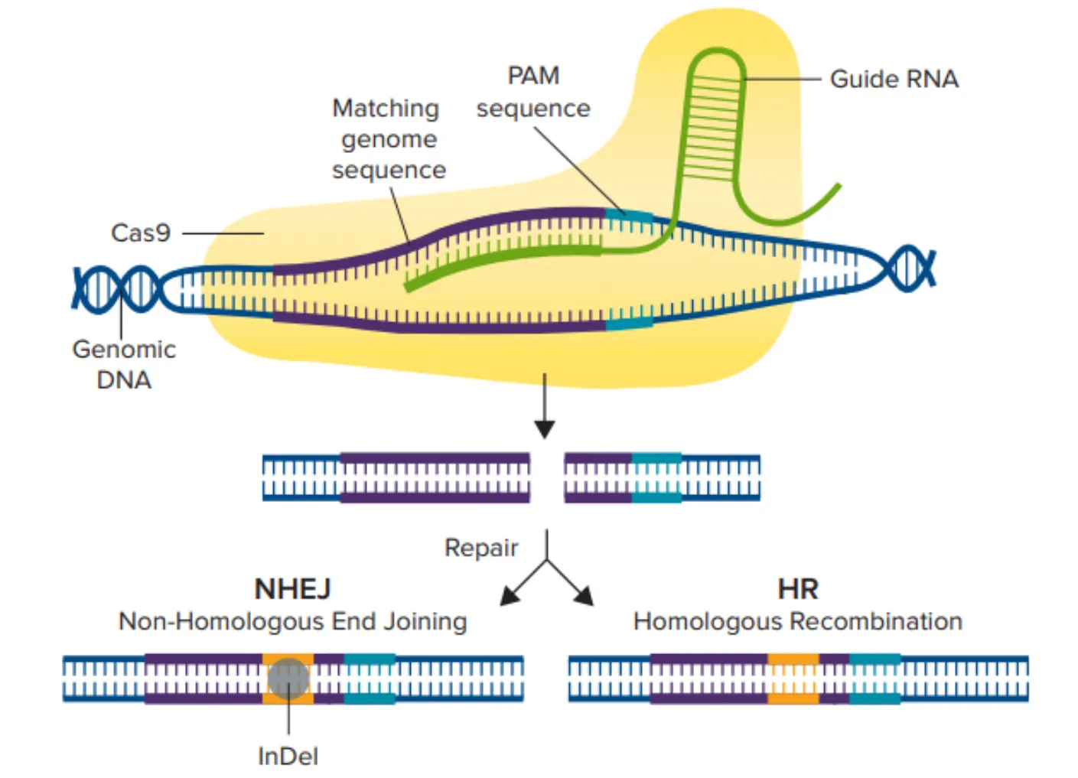
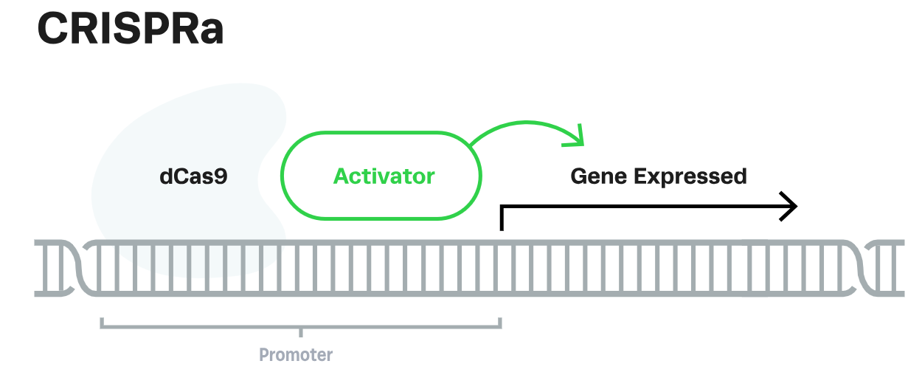
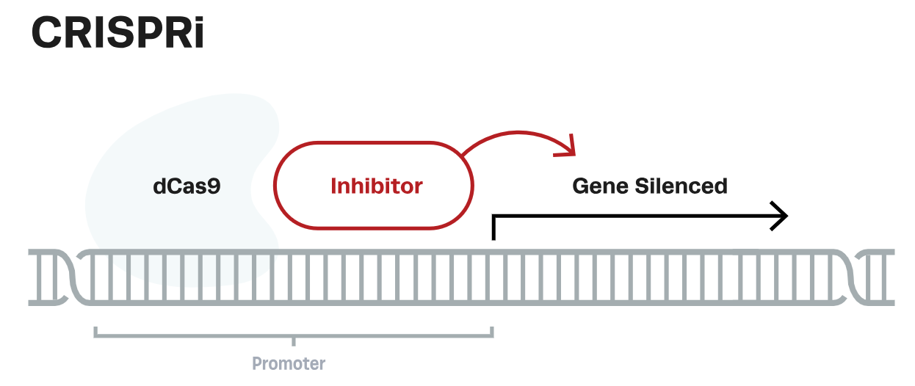
CRISPR-Cas9 tool mechanism
CRISPR
sgRNA targets the coding region (exons) of the gene.
The active Cas9 nuclease makes a double-strand break upstream of a PAM sequence → DNA repair by NHEJ introduces insertions/deletions → frameshift mutation → premature stop codon → (nonsense-mediated mRNA decay) → loss of function (KO).
sgRNA binds near the transcription start site.
The catalytically dead Cas9 nuclease (dCas9) is fused to an activator like VP64, p300 (CRISPRa) or to a repressor like KRAB (CRISPRi) and is recruited by the sgRNA to activate (CRISPRa) or silence (CRISPRi) gene expression.

Slide 6
Perturb-seq Experimental Design

Slide 7
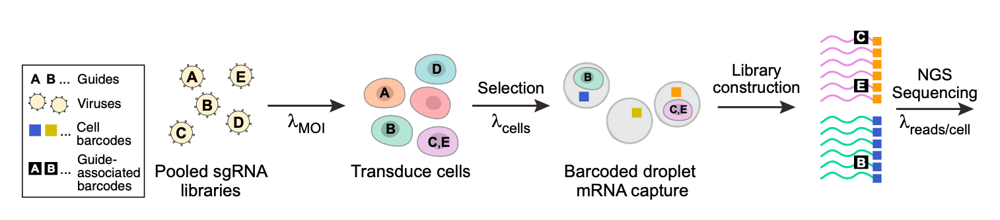
Scalable single-cell RNA profiling of pooled genetic screens

Slide 8
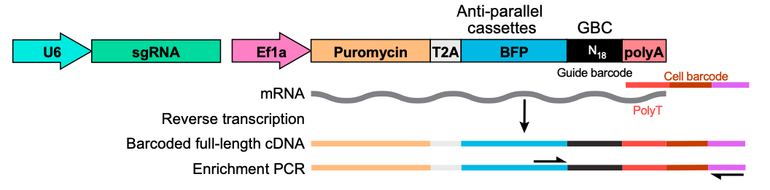
CRISPR plasmid design for perturbation identification at the single-cell resolution
U6 | Strong RNA polymerase III promoter, drives transcription of small RNAs like sgRNAs.
sgRNA | Directs Cas9 to the target gene, has a 20 –nt spacer sequence (target-specific) and a scaffold (Cas9-binding structure).
EF1a | Strong RNA polymerase II promoter, drives transcription of protein-coding sequences.
Puromycin | Encodes an enzyme that confers resistance to puromycin, an antibiotic. → Selection of transduced cells.
T2A | A self-cleaving peptide sequence that allows expression of multiple proteins from a single transcript.
BFP | Fluorescent reporter. → Selection of transduced cells.
GBC | Provides a readable tag in the scRNA-seq data that specifies which perturbation was introduced into the cell.
polyA | A polyadenylation signal, that ensures the transcript (Puromycin-T2A-BFP-GBC) gets a poly(A) tail, mandatory for perturbation identification during scRNA-seq.

Slide 9
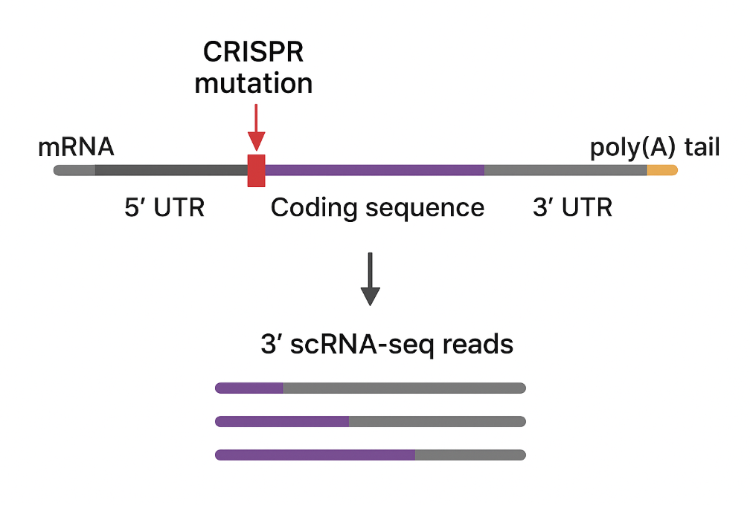
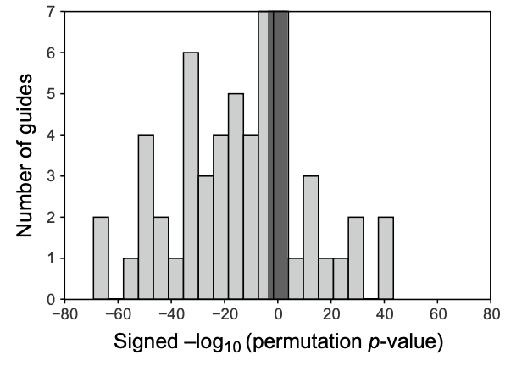
Effects of sgRNAs on target gene expression
How to analyse this figure?
p>0.05
sgRNAs that have no significant effect on target gene expression.
The majority of the sgRNAs effectively reduced the expression of their target genes.
p>0.05
sgRNAs lead to less target gene transcript.
p>0.05
sgRNAs lead to more target gene transcript.
CRISPR/Cas9 KO ≠ transcriptional silencing ➔ Protein function is lost but RNA transcription continues.
Hypotheses for paradoxical increase in target gene expression:
The target gene may normally act as a self-repressor; loss of its protein product removes this repression, leading to higher transcription.
The cell may sense the loss of protein function and trigger feedback mechanisms that upregulate transcription of the same gene to restore balance.
Technical artifact: mutant transcripts created after CRISPR editing may escape nonsense-mediated decay, so RNA is still detected even if no functional protein is produced.

Slide 10
The MIMOSCA Modelling Framework

Slide 11
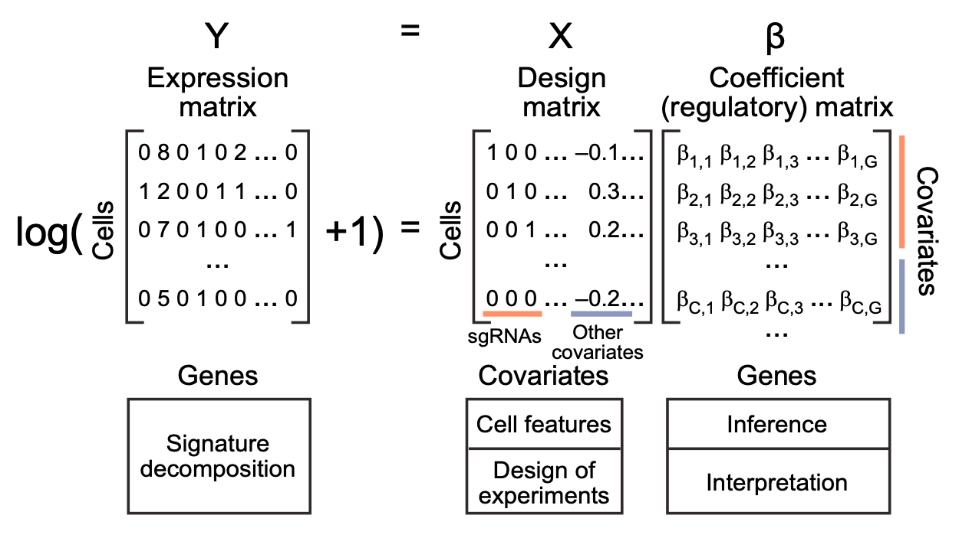
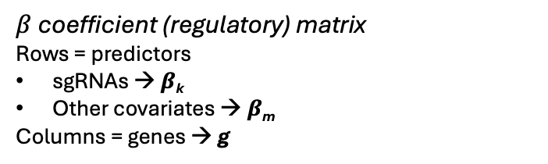
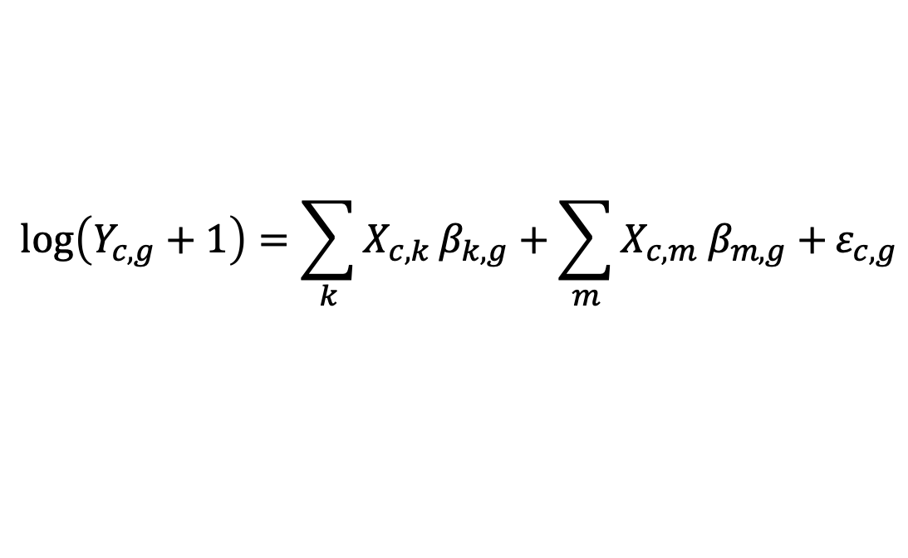
How to estimate the impact of perturbations on gene expression?
Y expression matrix
Rows = cells → c
Columns = genes → g
X design matrix
Rows = cells → c
Columns = predictors
sgRNAs – binary coding → k
Other covariates → m
$β$ coefficient (regulatory) matrix
Rows = predictors
sgRNAs → $β$_{k}
Other covariates → $β$_{m}
Columns = genes → g
sgRNA term
Other covariates term
$$\log\left(Y_{c, g}+1\right)=\sum_{k}{X_{c,k}}β_{k,g}+\sum_{m}{X_{c,m} β_{m,g}+}ε_{c,g}$$
Gene expression term
Residual error for gene g in cell c

Slide 12
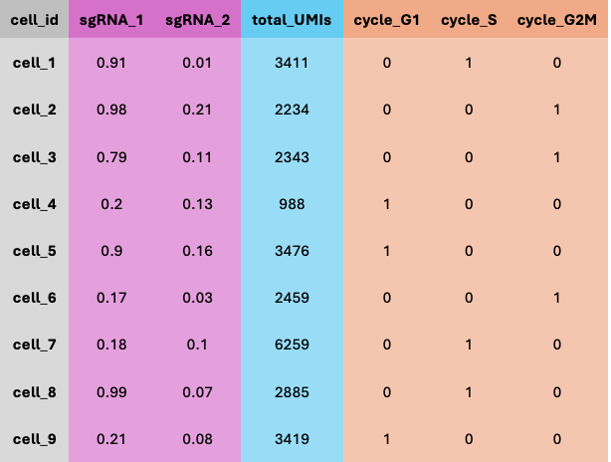
What is a covariate? Which covariates are included in MIMOSCA?
Covariate: Variable that is related to the outcome but is not the primary variable of interest in the study.
1 – Cell quality covariate
This is a continuous variable defined as the number of observed transcripts per cell (total UMIs). It accounts for capture efficiency or sequencing depth differences among cells.
X design matrix
2 – Cell state covariate
Cells exist in different biological states (subtypes, cell cycle stages, etc.). In a parallel experiment, unperturbed cells are classed into states using clustering / known markers. Then, each perturbed cells are assigned with the most likely state based on their transcriptome. This categorical covariate is encoded as dummy variables (one-hot vectors).
Cell cycle stages: G1, S, G2/M → 3 binary columns in the X matrix.
Cell subtypes: A, B, C, D, E, F, G, H → 7 binary columns in the X matrix.
Refinement of the perturbation assignment
Not all cells that get assigned a sgRNA show the expected knockout signature (due to editing inefficiency, dropout, etc.). Then, the perturbation weight must be revised. Instead of being treated as binary, as in the initial MIMOSCA, a probability weight is estimated for each cell:
Step 1: Fit an initial model to see which genes respond to the sgRNA.
Step 2: For each cell, check whether its transcriptome is consistent with that perturbation.
Step 3: Assign a probability that the perturbation was successful.

Slide 13
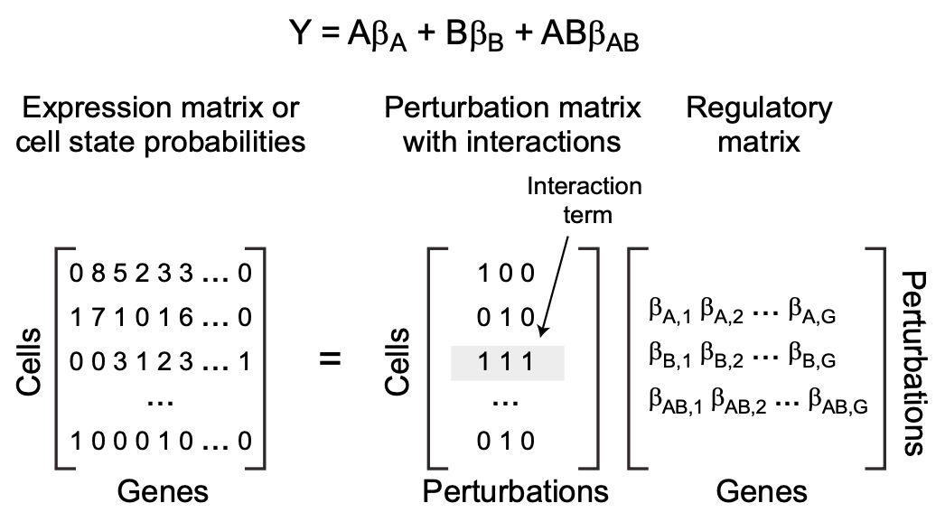
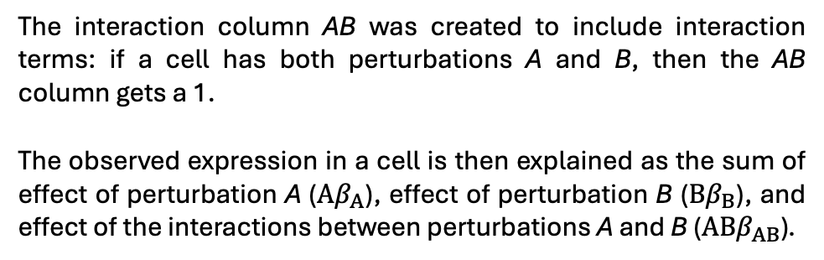
Incorporating genetic interactions into the model
A | B | AB
1 | 0 | 0
0 | 1 | 0
1 | 1 | 1
…
0 | 1 | 0
The interaction column AB was created to include interaction terms: if a cell has both perturbations A and B, then the AB column gets a 1.
The observed expression in a cell is then explained as the sum of effect of perturbation A ($Αβ_{Α}$), effect of perturbation B ($Ββ_{Β}$), and effect of the interactions between perturbations A and B ($ΑΒβ_{ΑΒ}$).

Slide 14
Experimental Validation: BMDC Response to LPS

Slide 15
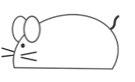

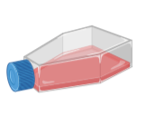

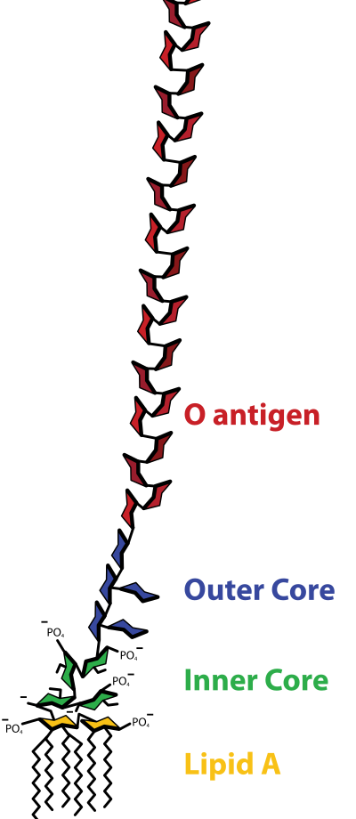

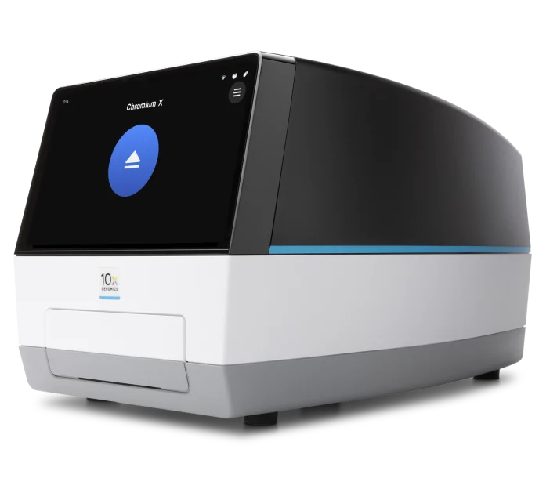
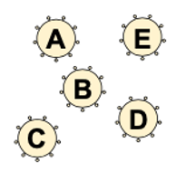
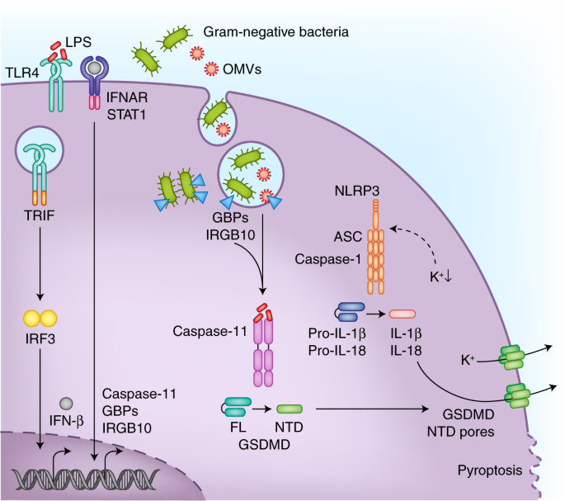
Experimental design
Cas9 transgenic mouse (constitutive expression of Cas9)
Day 2
BMDCs + sgRNAs
Selection of transduced cells
(antibiotic/BFP)
Day 9
BMDCs + sgRNAs + LPS
Bone marrow
BMDCs
0 hr
Lentiviral pool targeting 24 TFs (67 sgRNAs)
3 hr
TLR4/LPS signal transduction pathway
scRNA-seq
BMDCs are a well-studied dendritic cell model that express TLR4 and produce a strong, heterogeneous transcriptional response to LPS.

Slide 16
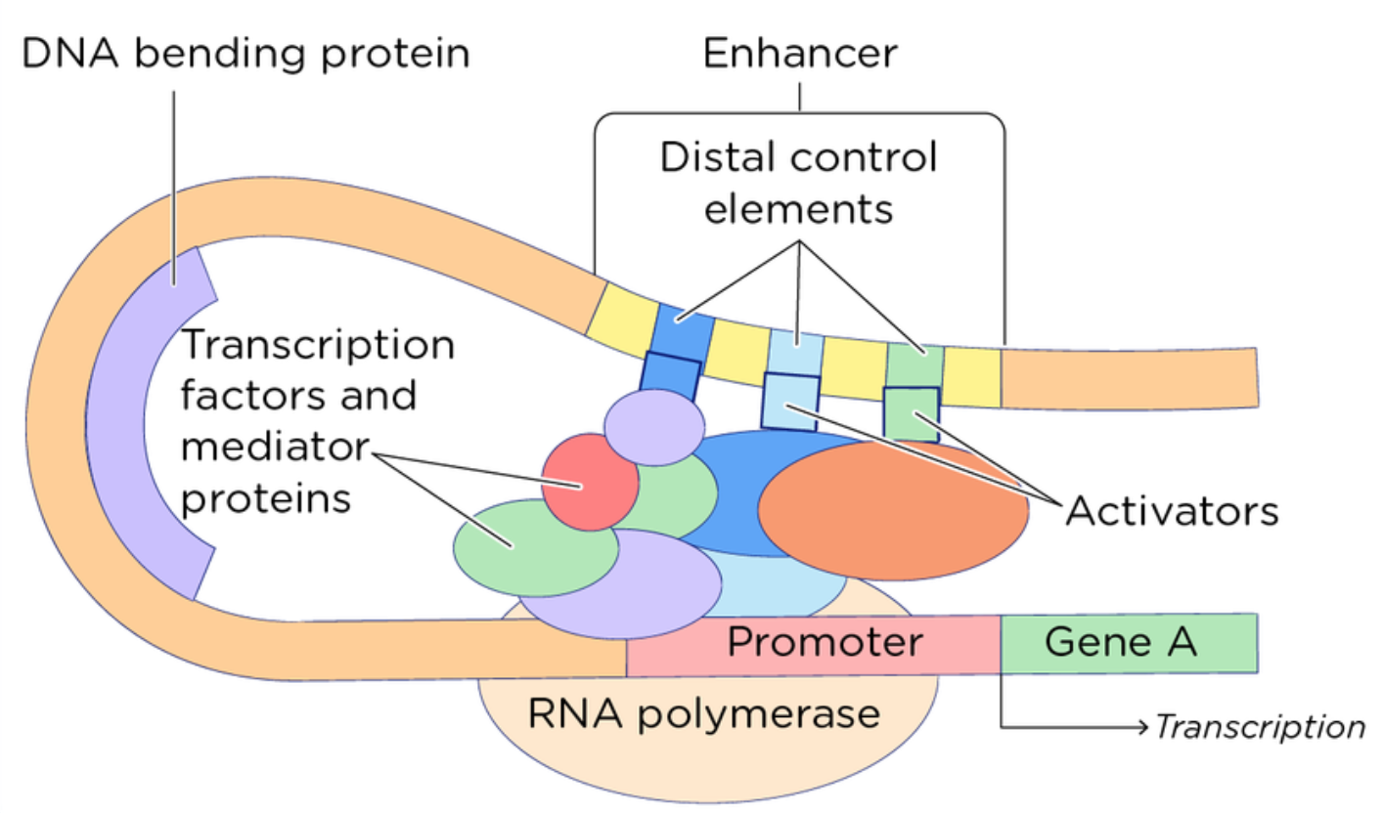
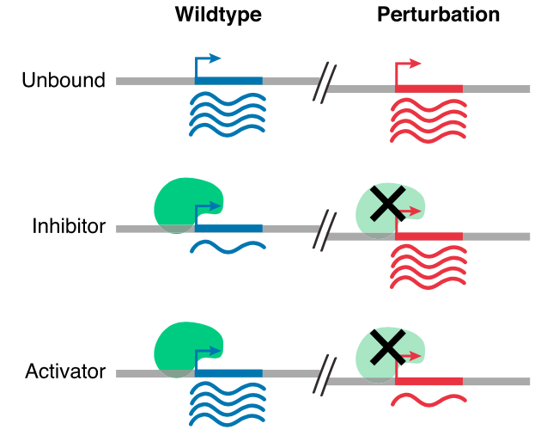
Mode of action of transcription factors
Transcription factors recognize and bind to specific sequences in promoters (close to the transcription start site) or enhancers/silencers (can be far away).
They recruit cofactors that either open or close chromatin, which in turn controls whether RNA polymerase II can initiate transcription.
The interplay of multiple transcription factors at promoters and enhancers/silencers fine-tunes gene expression in response to signals.

Slide 17
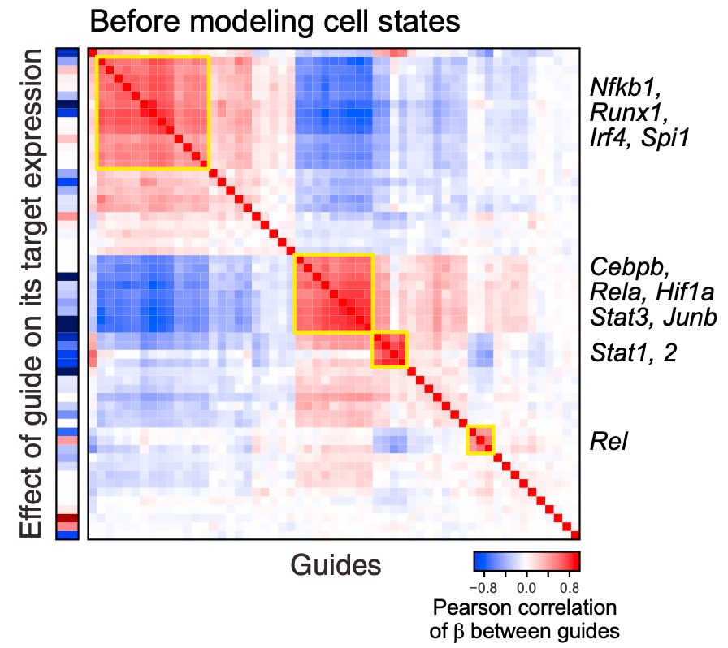
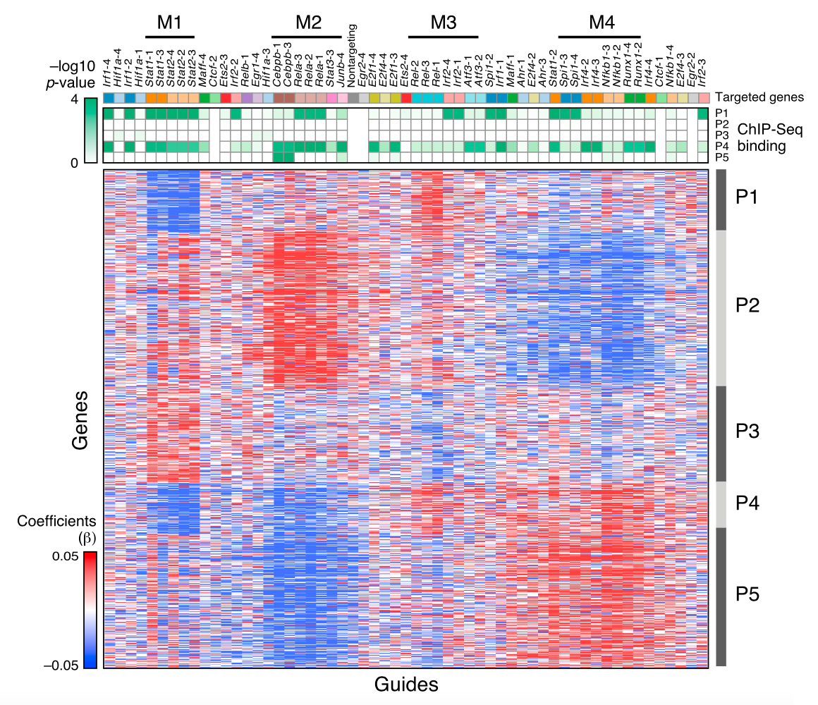
Controls before data analysis

Slide 18
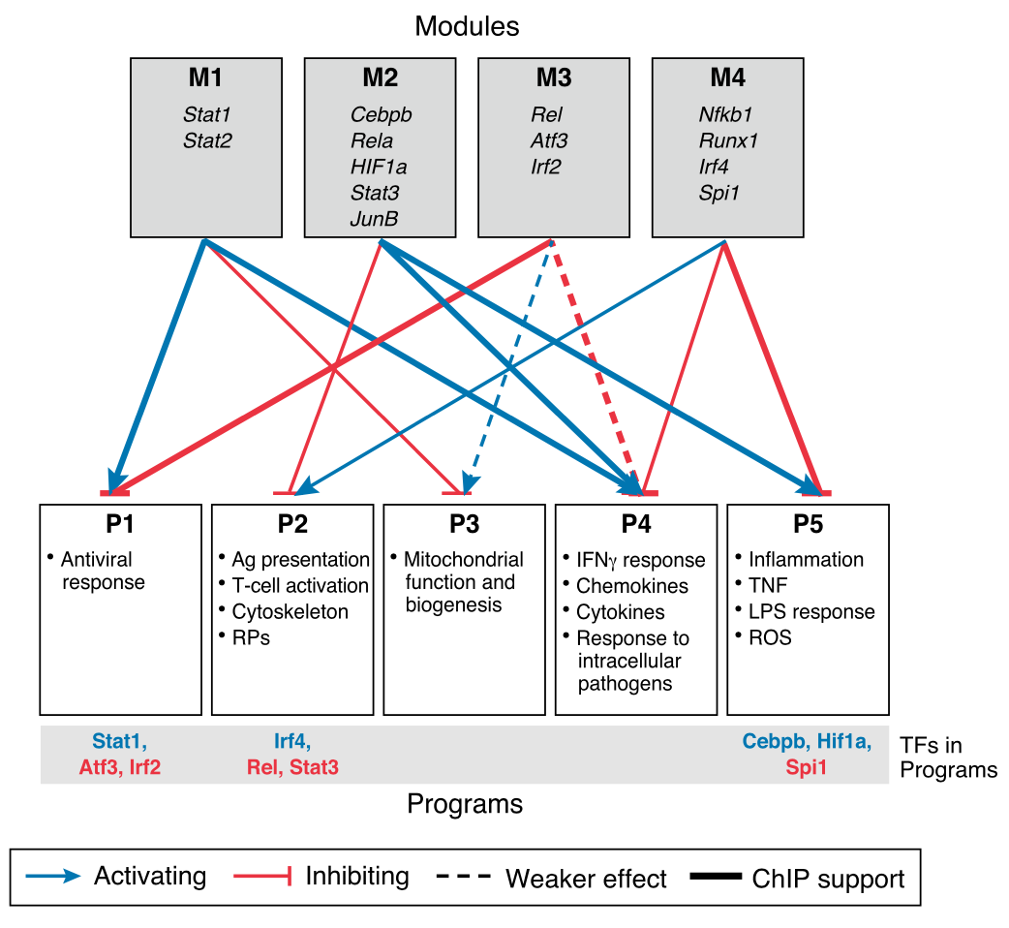
Finding 1: Transcription factor modules and gene programs

Slide 19
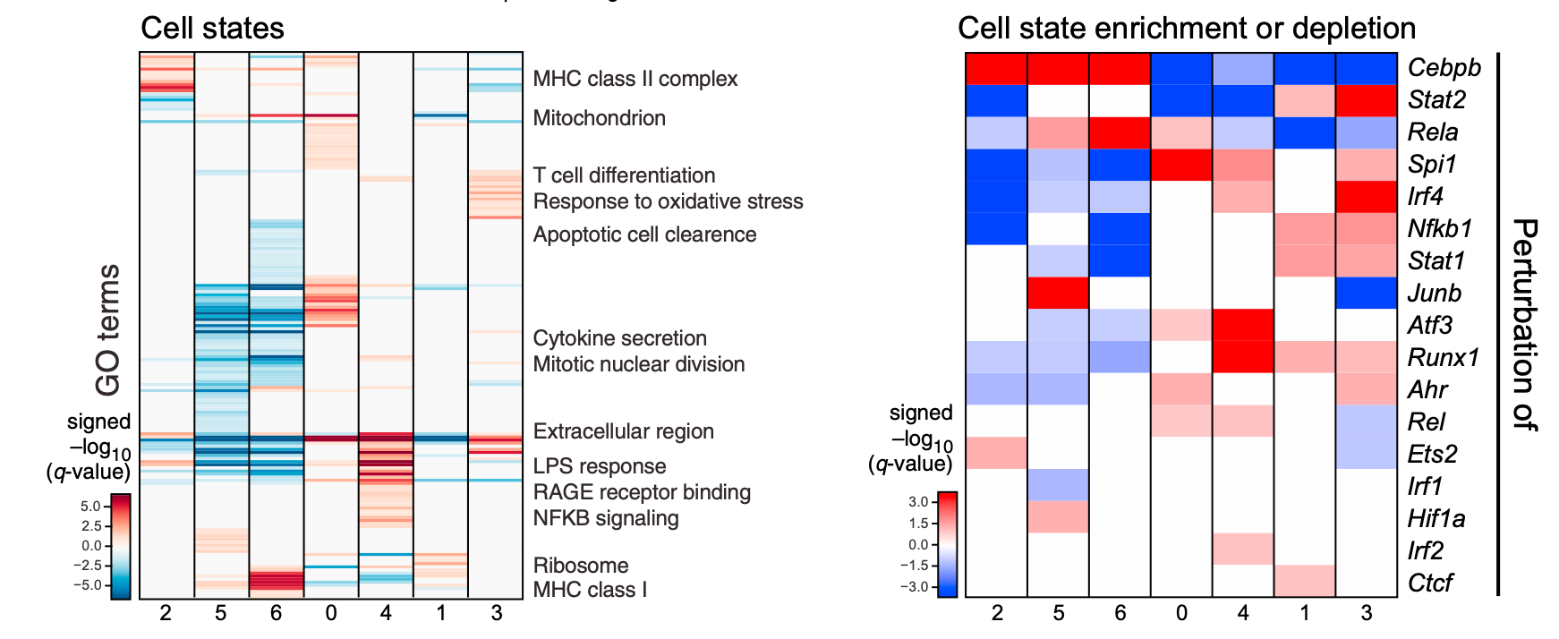
Finding 2: Seven distinct BDMC cell states under LPS stimulation

Slide 20
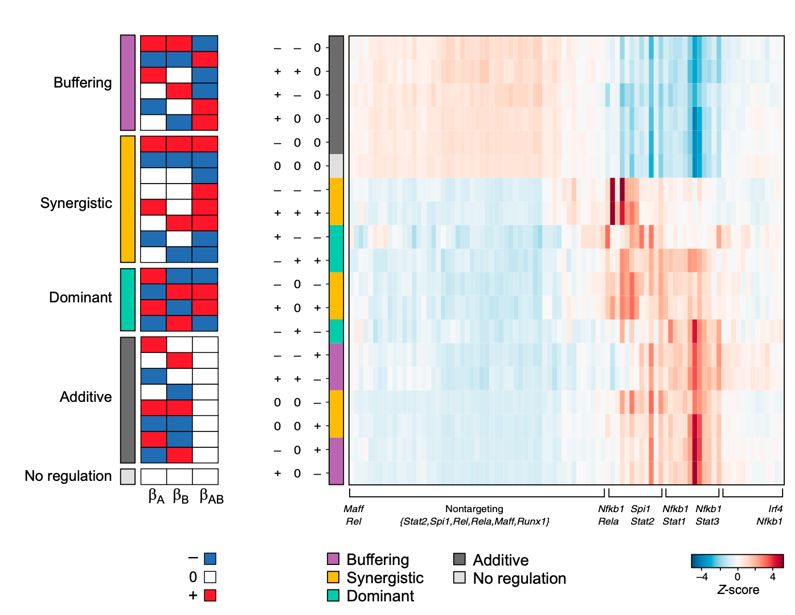
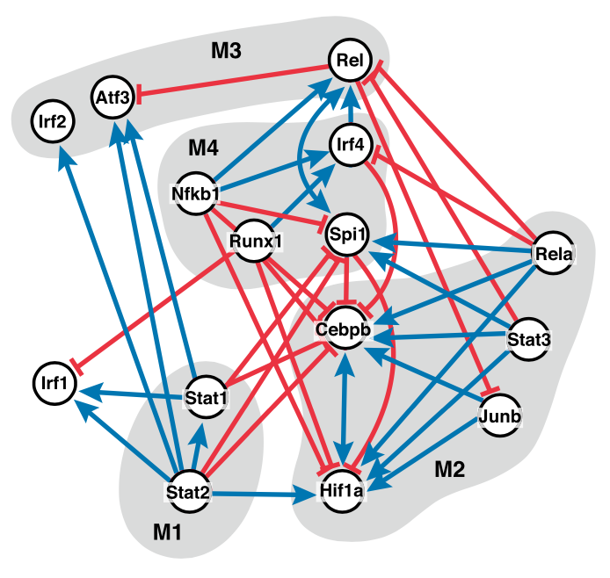
Finding 3: Complex transcription factor circuits and interactions

Slide 21
Discussion

Slide 22
Advantages and limitations of Perturb-seq
Advantages | Limitations
High-throughput functional genomics | High cost and technical complexity
Single-cell resolution | Limited scale compared to pure CRISPR screens
Unbiased readout | Noise and dropout in scRNA-seq
Rich functional insights | Detection of perturbations is probabilistic
Pooled experimental design | Indirect readouts
Compatibility with different CRISPR modalities | Analysis complexity

Slide 23
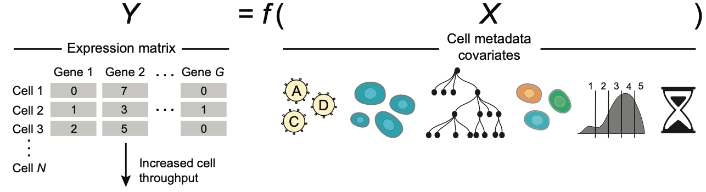
Potential improvements

Slide 24

How could you use this kind of approach in your own research project?
Let’s take 5 minutes and think about how single cell RNA profiling of pooled genetic screens could help you in your research project.

